Slide 1
Customer Relationship Management Project Report
Presented By
OGO CHUKWUEMEKA OKEREKE

Slide 2
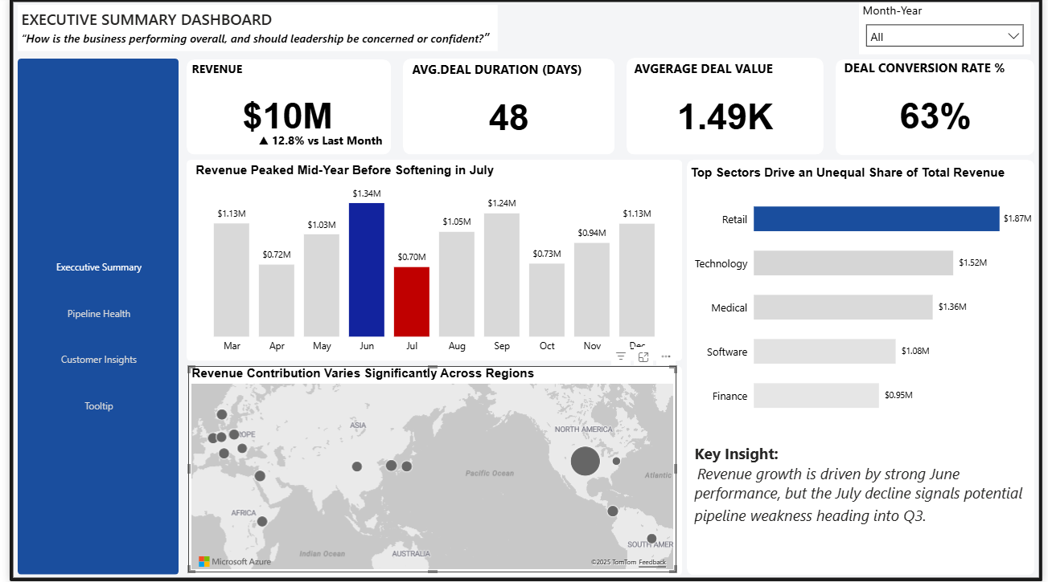

Slide 3
Problem Statement (Strategy-Focused)
The organization needs a data-driven view of its sales pipeline and customer base to identify revenue drivers, uncover pipeline inefficiencies, and manage customer and sector concentration risk in order to support informed strategic decision-making.

Slide 4
Data Origin, Cleaning And Transformation
The dataset for this project was obtained from the Maven Analytics Website.
It contains 8,800 rows of data spread across 4 tables which are:
Fact-Sales-Pipeline Table
Product Table
Sales Team Table
Account Table.
The data was cleaned, transformed and loaded through Power Query into Power BI for analysis.

Slide 5
Key Project Objectives
This project is aimed at providing answers to 3 critical business questions which are:
“What is driving revenue performance across the business?”
“Where and why are sales opportunities being delayed or lost?”
“Who is generating the most value, and where is customer risk emerging?”

Slide 6
Key Performance Indicators
Total Revenue provides an immediate view of overall business performance, but its concentration among a small set of customers signals growth vulnerability if key accounts are lost.
The win rate highlights how efficiently the sales pipeline converts opportunities into revenue, making it a direct indicator of sales effectiveness and process quality.
A high revenue share from the top customers indicates strong key-account performance but exposes the business to concentration and churn risk.

Slide 7
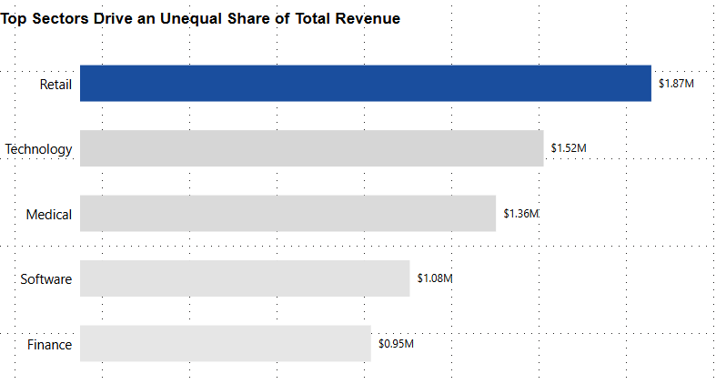
Top Sectors Drive an Unequal Share of the Revenue
Revenue performance is uneven across sectors, with a small number of sectors contributing a large share of total revenue.

Slide 8
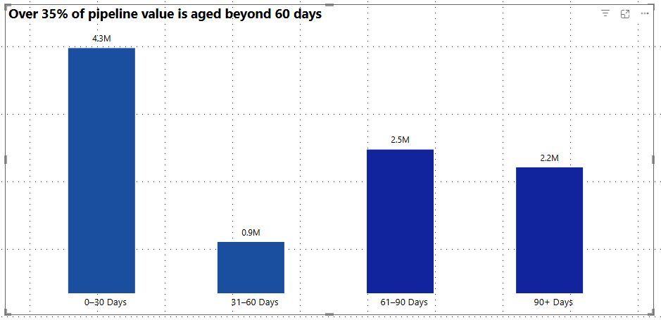
Over 35% of Pipeline Deal Values is Aged Above 60 Days
A significant share of pipeline value is locked in deals aged over 60 days, indicating potential revenue delay and conversion risk.

Slide 9
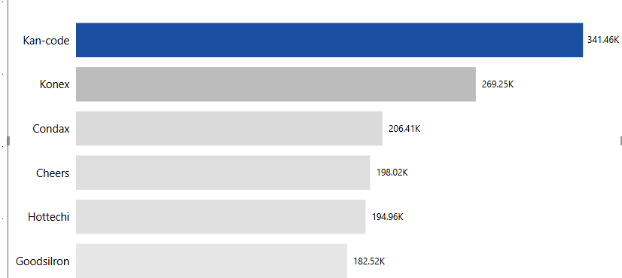
Revenue Is Concentrated Among Key Customers
Customer revenue is highly concentrated, making churn among top customers a critical business risk.

Slide 10
Recommendations
Focus growth and sales efforts on the highest-performing sectors while monitoring revenue concentration to manage risk.
Actively review and escalate deals aged beyond 60 days to reduce pipeline delays and improve conversion.
Protect top revenue-generating customers while developing mid-tier accounts to reduce customer concentration risk.

Slide 11
Conclusion
In conclusion, by prioritizing high-performing sectors, addressing pipeline bottlenecks, and balancing customer portfolio development, the business can drive sustainable growth, improve conversion efficiency, and reduce revenue concentration risk.

